Slide 1
Image Segmentation
Last updated: 09-10-2024
[MS] Mubarak S., Fundamentals of Computer Vision, 1997. (Ch. 2)
[SR] Szeliski R., Computer Vision - Algorithms and Applications, Springer, 2011. (Ch. 4, 5)
[GR1] Gonzalez R. C., Woods R. E., Eddins S. L., Digital Image Processing Using Matlab, Pearson Education, 2nd edition, 2009. (Ch. 10)
[GR2] Gonzalez R. C., Woods R. E., Eddins S. L., Digital Image Processing, Pearson Education, 3rd edition, 2007. (Ch. 10)
Dr. Zulfiqar Habib, Professor
http://vig.cuilahore.edu.pk

Slide 2
Image Segmentation
Model Generation
Models
Image acquisition
Preprocessing
Segmentation
Feature extraction
Classification / Regression
Problem domain
Knowledge base
Result
Notes:
Regression and classification are categorized under the same umbrella of supervised machine learning. ... The main difference between them is that the output variable in regression is numerical (or continuous) while that for classification is categorical (or discrete)

Slide 3
Segmentation Techniques
The main types of image segmentation techniques include:
Thresholding: Separates regions based on intensity values.
Clustering: Groups pixels into clusters, such as k-means clustering.
Edge-Based Segmentation: Uses edge detection to identify boundaries.
Region-Based Segmentation: Groups pixels based on region-growing methods.
Deep Learning-Based Segmentation: Uses neural networks for pixel-wise classification, such as Convolutional Neural Network (CNN) and Deep Neural Networks (DNN).

Slide 4
Thresholding
Thresholding enjoys a central position in image segmentation.
First we will continue to look at the problem of segmentation, this time though in terms of thresholding.
In particular we will look at:
What is thresholding?
Simple thresholding
Adaptive thresholding

Slide 5
Simple Thresholding
Thresholding is usually the first step in any segmentation approach
Single value thresholding can be given mathematically as follows:

Slide 6
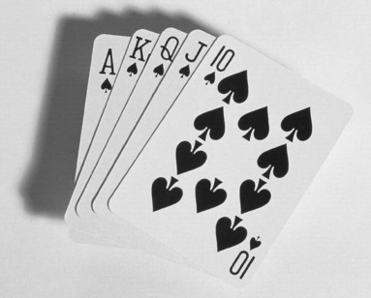

Thresholding Example
Imagine a poker playing robot that needs to visually interpret the cards in its hand
Original Image
Thresholded Image

Slide 7
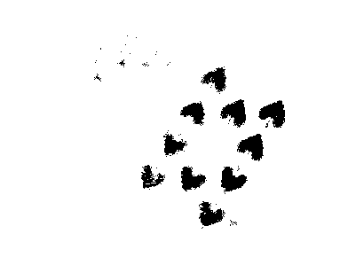
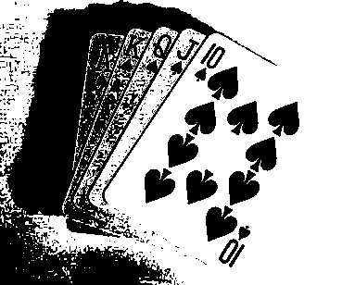
But Be Careful
If you get the threshold wrong the results can be disastrous
Threshold Too Low
Threshold Too High

Slide 8
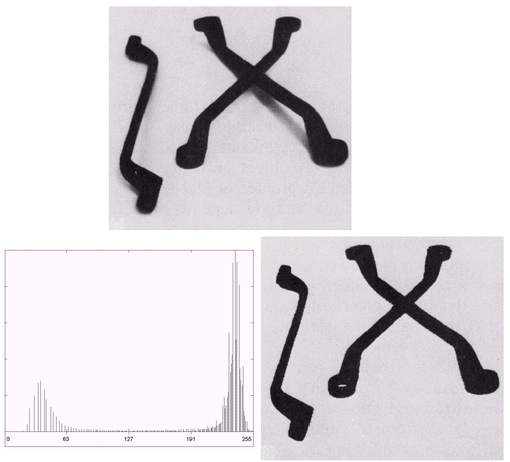
Basic Global Thresholding
Based on the histogram of an image
Partition the image histogram using a single global threshold
The success of this technique very strongly depends on how well the histogram can be partitioned

Slide 9
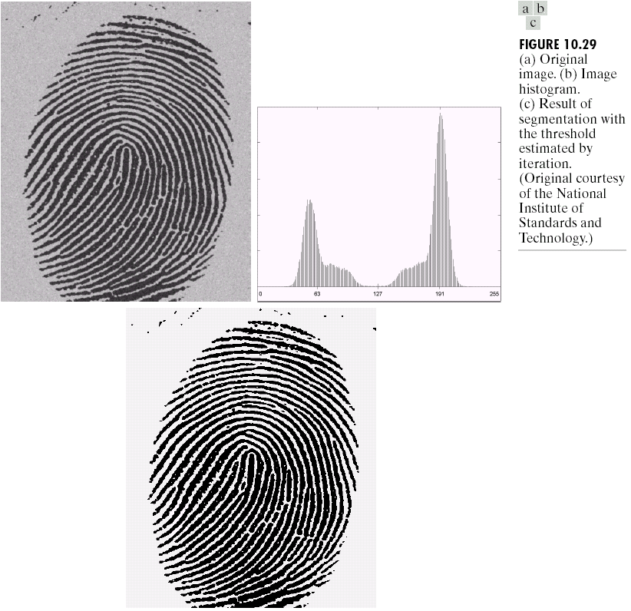

Basic Global Thresholding
Images taken from Gonzalez & Woods, Digital Image Processing (2002)

Slide 10
Basic Global Thresholding Algorithm
The basic global threshold, T, is calculated
as follows:
Select an initial estimate for T (typically the average grey level in the image)
Segment the image using T to produce two groups of pixels:
G₁ consisting of pixels with grey levels >T and
G₂ consisting pixels with grey levels ≤ T
Compute the average grey levels of pixels in G₁ to give μ₁ and G₂ to give μ₂

Slide 11
Basic Global Thresholding Algorithm
Compute a new threshold value:
Repeat steps 2 – 4 until the difference in T in successive iterations is less than a predefined parameter T₀
This algorithm works very well for finding thresholds when the histogram is suitable

Slide 12
Thresholding using Otsu Method
We start by treating the normalized histogram as a discrete pdf with
where n is the number of pixels in the image, n_{q} is the number of pixels that have intensity level r_{q} and L is the total number of possible intensity levels in the image.
Suppose that a threshold k is chosen s.t. C₀ is the set of pixels with levels [0, 1, ..., k-1] and C₁ is the set of pixels with levels [k, k+1, ..., L-1].

Slide 13
Thresholding using Otsu Method
Otsu method choses the threshold value k that maximizes the between-class variance
where

Slide 14
Thresholding using Otsu Method
T = graythresh(f)
takes an image, computes its histogram, and then finds the threshold value that maximizes the between-class variance.
The threshold is returned as a normalized value between 0.0 and 1.0, where f is the input image and T is the resulting threshold.

Slide 15
Thresholding using Otsu Method: Example
>> I = imread('coins.png');
>> imhist(I)
>> level = graythresh(I)
level =
0.4941
>> BW = im2bw(I,level);
>> imshow(BW)

Slide 16
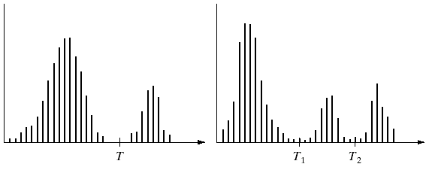
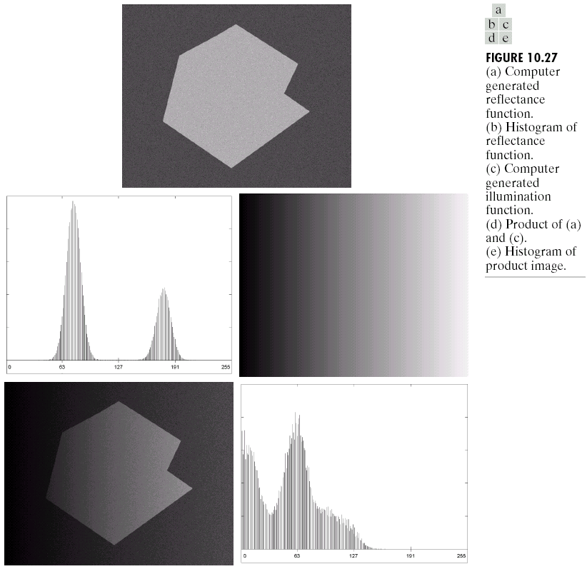
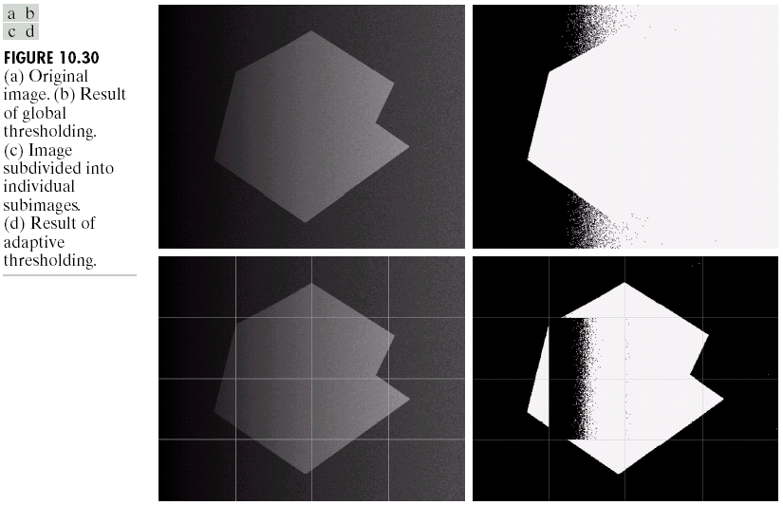
Problems With Single Value Thresholding…
Single value thresholding only works for bimodal histograms
Images with other kinds of histograms need more than a single threshold
Uneven illumination can really upset a single valued thresholding scheme
Images taken from Gonzalez & Woods, Digital Image Processing (2002)

Slide 17
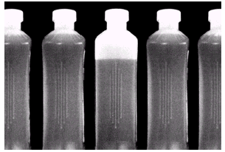
Problems With Single Value Thresholding
Let’s say we want to isolate the contents of the bottles.
Think about what the histogram for this image would look like.
>> b = imread('bottles.jpg');
>> imhist(b);
Images taken from Gonzalez & Woods, Digital Image Processing (2002)
What would happen if we use a single threshold value?

Slide 18
The Role of Uneven Illumination
Therefore, either balance the illumination or apply adaptive thresholding
Normal image
Intensity ramp in the range [0.2, 0.6]
Product of normal image and intensity ramp

Slide 19
Basic Adaptive Thresholding
An approach to handling situations in which single value thresholding will not work is to divide an image into sub images and threshold these individually
Since the threshold for each pixel depends on its location within an image this technique is called adaptive

Slide 20
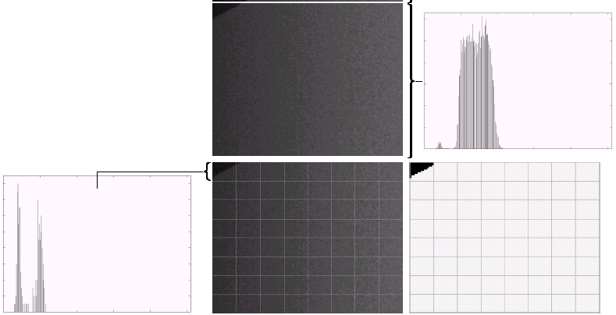
Basic Adaptive Thresholding: Example
The image shows an example of using adaptive thresholding with the image shown previously
As can be seen, success is mixed
But, we can further subdivide the troublesome sub images for more success
Further subdivided the troublesome part, successful thresholding is achieved

Slide 21
The Role of Noise in Image Thresholding
Therefore the noise should be removed before thresholding
Noiseless image
Image with additive Gaussian noise of mean 0 and standard deviation 10
Image with additive Gaussian noise of mean 0 and standard deviation 50

Slide 22
Segmentation
Segmentation attempts to partition the pixels of an image into groups that strongly correlate with the objects in an image
Typically the first step in any automated computer vision application

Slide 23
Segmentation of Water in Bottles
b = imread('bottles.jpg');
t=double(multithresh(b,2))/256
bL = im2bw(b,t(1));
bH = im2bw(b,t(2));
L = (bL-bH);
L1 = medfilt2(L,[9 9],'symmetric');
subplot(2,3,1),imshow(b),title('Bottles'),
subplot(2,3,2), imshow(bL), title('Liquid White'),
subplot(2,3,3), imshow(bH), title('Liquid Black'),
subplot(2,3,4), imshow(L), title('Liquid with noise'),
subplot(2,3,5), imshow(L1), title('Pure Liquid')
t =
0.2070 0.6758

Slide 24
Summary
We have begun looking at segmentation, and in particular thresholding
We saw the basic global thresholding algorithm and its shortcomings
We observed how noise or uneven illumination effect image segmentation
We also saw a simple way to overcome some of these limitations using adaptive thresholding

Slide 25
#Video Lectures
Overview
Segmentation by humans
Segmentation as Clustering
k-Means Segmentation
Mean-Shift Segmentation
Graph Based Segmentation
Notes:
https://fpcv.cs.columbia.edu/

